Slide 1
2. The Nature of Business
Topic 1. Understanding Economic Systems
Chapter 2. Productivity and the Business Cycle Unit 1. The Context of Business.
MXA101 – Introduction To Business
-By ManageX Academy

Slide 2
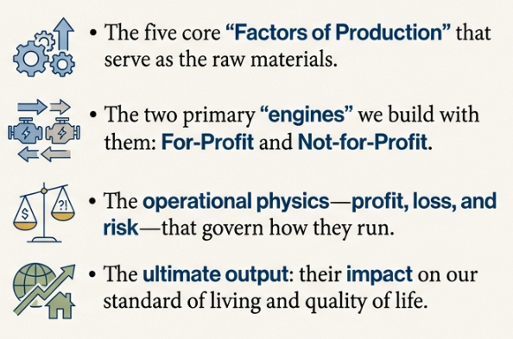
What is The Nature of Business?
Meaning of economic systems
Why businesses exist in an economy
Relationship between economy and daily life
Overview of business and nonprofit roles

Slide 3
Businesses in Our Everyday Life
Daily interaction with businesses
Physical stores vs digital platforms
Goods and services all around us
Invisible role of business in convenience

Slide 4
What Is a Business?
Definition of a business
Profit as a primary objective
Customer needs as the foundation
Value creation through exchange

Slide 5
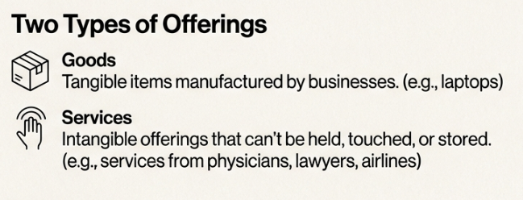
Goods vs Services
Tangible goods explained
Intangible services explained
Examples from modern economy
Why services dominate today’s economy

Slide 6
Businesses Serving Other Businesses
B2B transactions
Industrial goods and services
Supply chains and interdependence
Importance of backend businesses

Slide 7
Standard of Living Explained
Meaning of standard of living
Output of goods and services
Purchasing power concept
Prices vs income comparison

Slide 8
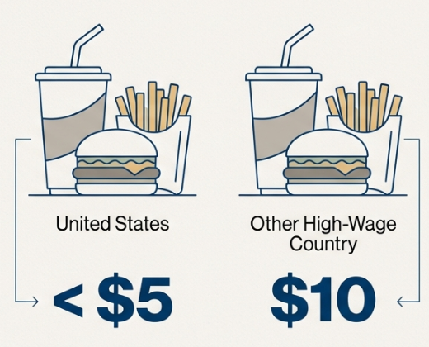
Standard of Living vs Income
Why higher wages don’t always mean better life
Role of cost of living
Purchasing power parity concept
Real-world global comparison

Slide 9
Quality of Life Explained
Difference between standard and quality of life
Health, education, leisure, safety
Role of businesses and government
Long-term societal impact

Slide 10
Business Contribution to Quality of Life
Job creation
Innovation and convenience
Infrastructure and services
Economic stability

Slide 11

Understanding Business Risk
Meaning of risk in business
Financial and operational risks
Goal failure risks
Why risk cannot be eliminated

Slide 12

Revenue, Cost, Profit, and Loss
Revenue explained
Cost components
Profit calculation
Loss situations

Slide 13
Risk–Reward Relationship
Higher risk, higher potential return
Conservative vs aggressive strategies
Market uncertainty
Competitive pressure

Slide 14
Importance of Adaptability
Changing customer preferences
Technology disruption
Market competition
Strategic flexibility

Slide 15
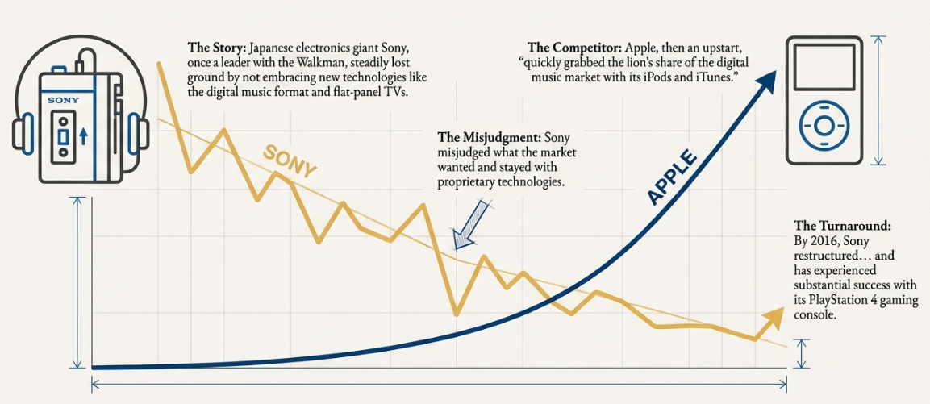
Case Insight – Technology Shift & Market Reality
Ignoring market signals
Proprietary vs open systems
Innovation timing
Business reinvention

Slide 16
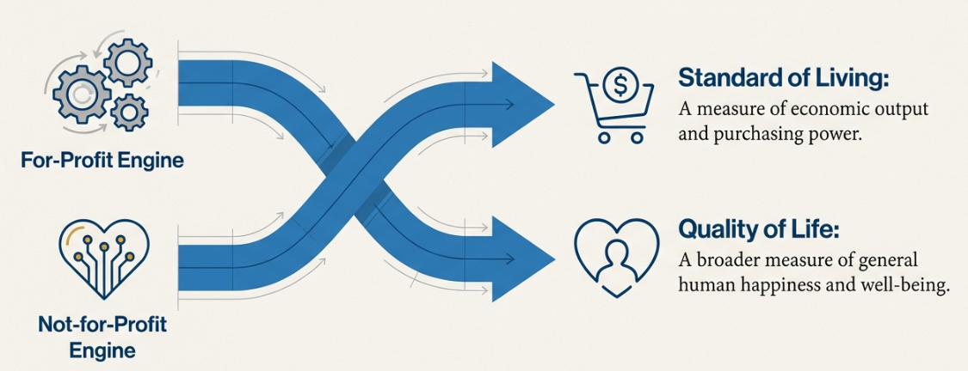
Introduction to Not-for-Profit Organization
Definition of nonprofits
Purpose beyond profit
Social and community focus
Examples of nonprofit sectors

Slide 17

Growth of the Nonprofit Sector
Increasing social needs
Employment and volunteer growth
Economic contribution
Government as a nonprofit entity

Slide 18
Goals of Nonprofit Organizations
Social impact goals
Mission-driven performance
Measuring success differently
Resource constraints

Slide 19
Competition in the Nonprofit World
Competition for donations
Competition for talent
Volunteer time limitations
Trust and reputation

Slide 20
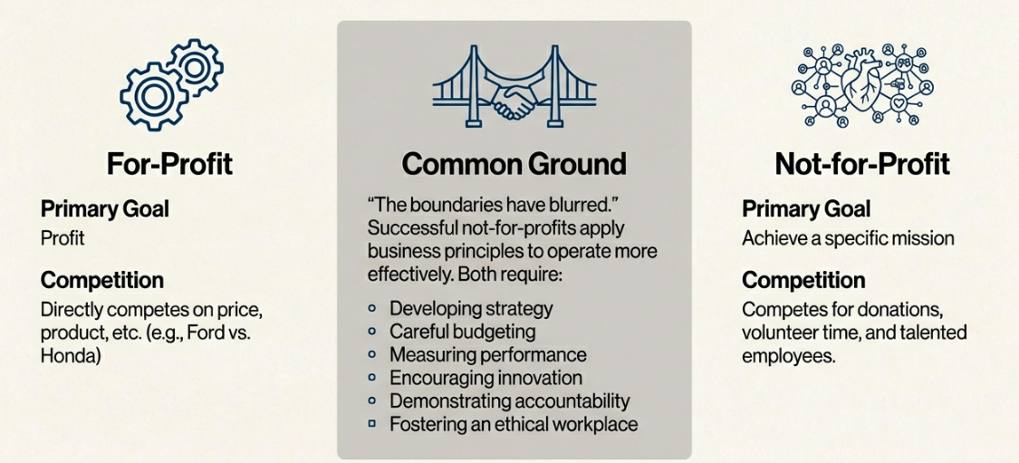
Blurring Lines Between Business & Nonprofits
Businesses addressing social issues
Nonprofits adopting business practices
Shared management principles
Ethical responsibilities

Slide 21
Managing a Modern Nonprofit
Strategy and planning
Financial discipline
Performance measurement
Governance and accountability

Slide 22
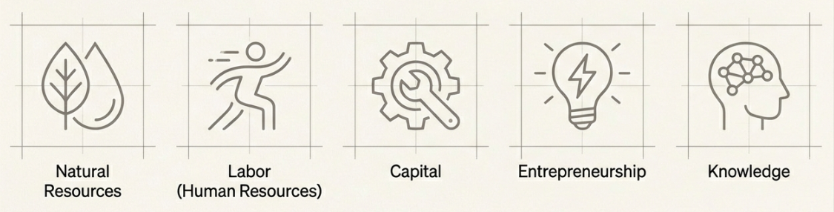
Factors of Production – Overview
Inputs required for production
Efficient resource utilization
Productivity improvement
Economic foundation

Slide 23
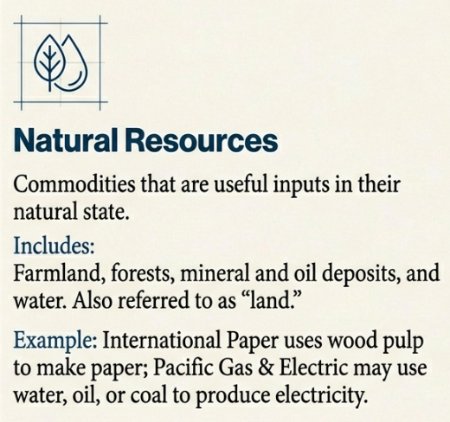
Natural Resources
Land, water, minerals
Energy resources
Environmental concerns
Sustainable usage

Slide 24
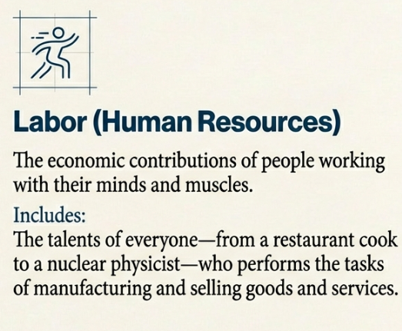
Labor (Human Resources)
Physical and mental effort
Skill diversity
Workforce productivity
Talent development

Slide 25
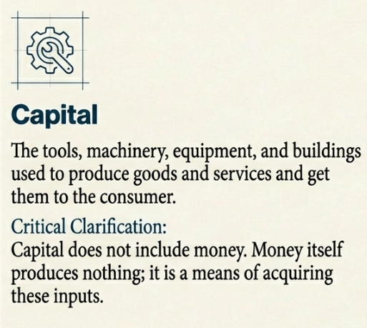
Capital
Tools and machinery
Infrastructure and buildings
Technology investment
Capital vs money

Slide 26
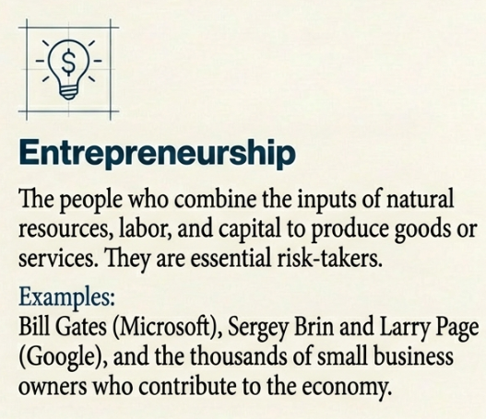
Entrepreneurship
Role of entrepreneurs
Risk-taking and innovation
Decision-making authority
Value creation

Slide 27

Knowledge as the Fifth Factor
Knowledge-based economy
Skills and learning
Technology and automation
Competitive advantage

Slide 28

Entrepreneurial Mindset
Comfort with uncertainty
Continuous change
Learning from failure
Long-term vision

Slide 29
Business Innovation & Change
Adapting business models
Technology adoption
Employee involvement
Customer-centric thinking

Slide 30
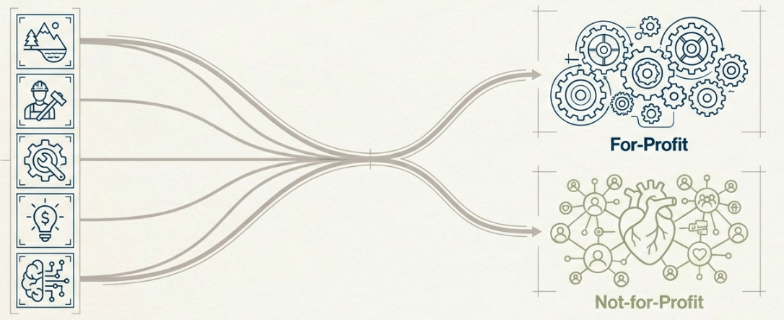
Productivity and Economic Growth
Efficient use of resources
Output maximization
Role of technology
National economic impact

Slide 31
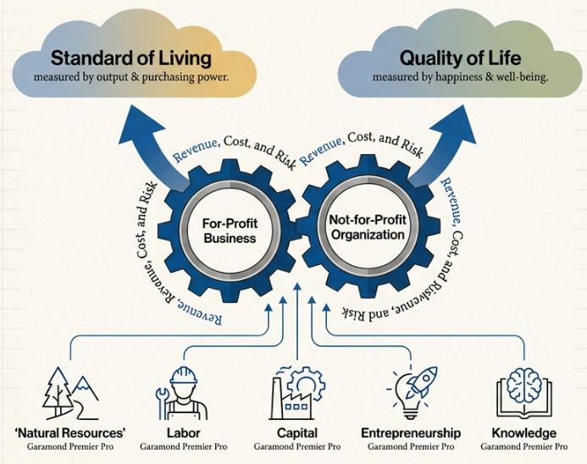
Key Takeaways for Managers & Entrepreneurs
Economy shapes opportunity
Business creates living standards
Risk and adaptability define success
Knowledge is the future driver

Slide 32


